Slide 1
Java Ready Reference
Nalinadevi Kadiresan

Slide 2
Outline
Part-1 Wrapper classes
Part-2 String and StringBuilder
Part-3 Array methods
Part-4 Collection Classes- Overview
Part-5 Comparable and comparator
Part-6 Vectors and Arraylist
Part-7 Iterator and Iterable
Part-8 Random Number
Part-9 Object Cloning
Part-10 File Operations

Slide 3
WRAPPER CLASSES
Part 1

Slide 4
Wrapper Classes
The java.lang package contains wrapper classes that correspond to each primitive type:
Note: each Class is capitalized, as should be all classes.
Primitive Type | Wrapper Class
byte | Byte
short | Short
int | Integer
long | Long
float | Float
double | Double
char | Character
boolean | Boolean
void | Void

Slide 5
Value => Object: Wrapper Object Creation
Wrapper.valueOf() takes a value (or string) and returns an object of that class:
Integer i1 = Integer.valueOf(42);
Integer i2 = Integer.valueOf(“42”);
Boolean b1 = Boolean .valueOf(true);
Boolean b2 = Boolean .valueOf(“true”);
Long n1 = Long.valueOf(42000000L);
Long n1 = Long.valueOf(“42000000L”);

Slide 6
Object => Value
Each wrapper class Type has a method typeValue to obtain the object’s value:
Integer i1 = Integer.valueOf(42);
Boolean b1 = Boolean.valueOf(“false”);
System.out.println(i1.intValue());
System.out.println(b1.intValue());
=>
42
false

Slide 7
String => value
The Wrapper class for each primitive type has a method parseType() to parse a string representation & return the literal value.
Integer.parseInt(“42”) => 42
Boolean.parseBoolean(“true”) => true
Double.parseDouble(“2.71”) => 2.71
//…
Common use: Parsing the arguments to a program:

Slide 8
Each Number Wrapper has a MAX_VALUE constant:
byteObj = new Byte(Byte.MAX_VALUE);
shortObj = new Short(Short.MAX_VALUE);
intObj = new Integer(Integer.MAX_VALUE);
longObj = new Long(Long.MAX_VALUE);
floatObj = new Float(Float.MAX_VALUE);
doubleObj = new Double(Double.MAX_VALUE);
printNumValues("MAXIMUM NUMBER VALUES:");
=>
Byte: 127
Short: 32767
Integer: 2147483647
Long: 9223372036854775807
Float: 3.4028235E38
Double: 1.7976931348623157E308
Similarly, there is MIN_VALUE

Slide 9
Many useful utility methods, e.g., for Integer:
int hashCode()
static int numberOfLeadingZeros(int i)
static int numberOfTrailingZeros(int i)
static int reverse(int i)
static int reverseBytes(int i)
static int rotateLeft(int i, int distance)
static int rotateRight(int i, int distance)
static String toBinaryString(int i)
static String toHexString(int i)
static String toOctalString(int i)
static String toString(int i, int radix)

Slide 10
Double & Float: Utilities for Arithmetic Operations:
Constants POSITIVE_INFINITY & NEGATIVE_INFINITY
Constant NaN = Not-a-Number (NaN) value.
Methods isNaN(), isInfinite()

Slide 11
String AND StringBuilder
PART 2

Slide 12
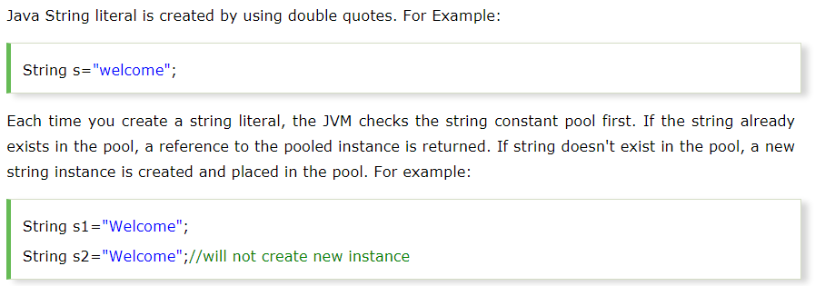
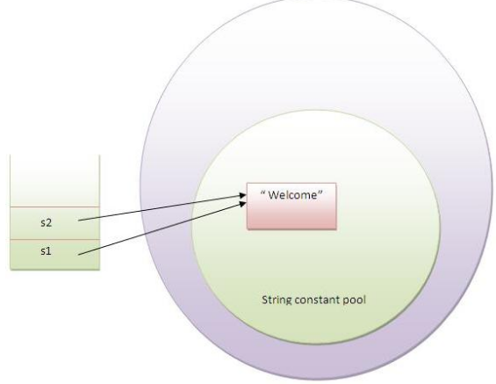
String

Slide 13
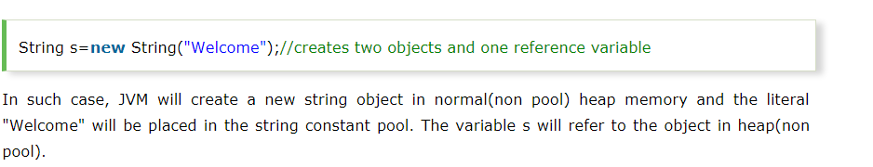
String – new keyword
public class StringExample{
public static void main(String args[]){
String s1="java";//creating string by java string literal
char ch[]={'s','t','r','i','n','g','s'};
String s2=new String(ch);//converting char array to string
String s3=new String("example");//creating java string by new keyword
System.out.println(s1);
System.out.println(s2);
System.out.println(s3);
}}

Slide 14
String - Copy Constructors
Copy constructor creates a copy of an existing String. Also rarely used.
Not the same as an assignment.
Copy Constructor: Each variable points to a different copy of the String.
String word = new String(“Java”);
String word2 = new String(word);
word
“Java"
word2
“Java"
Assignment: Both variables point to the same String.
String word = “Java”;
String word2 = word;
word
“Java"
word2

Slide 15
String - Advantages Of Immutability
Uses less memory.
String word1 = "Java";
String word2 = word1;
String word1 = “Java";
String word2 = new String(word1);
word1
word1
“Java"
“Java"
word2
“Java"
word2
Less efficient: wastes memory
OK

Slide 16

String - Disadvantages of Immutability
Less efficient — you need to create a new string and throw away the old one even for small changes.
String word = “Java";
char ch = Character.toUpperCase(word.charAt (0));
word = ch + word.substring (1);
word
“java"
“Java"

Slide 17
String Methods — length, charAt
int length();
char charAt(i);
Returns the number of characters in the string
Returns the char at position i.
Character positions in strings are numbered starting from 0 – just like arrays.
Returns:
”Problem".length();
”Window".charAt (2);
7
’n'

Slide 18
String Methods — substring
Returns a new String by copying characters from an existing String.
String subs = word.substring (i, k);
  returns the substring of chars in positions from i to k-1
String subs = word.substring (i);
  returns the substring from the i-th char to the end
television
i k
television
i
Returns:
”television".substring (2,5);
“immutable".substring (2);
“bob".substring (9);
“lev"
“mutable"
"" (empty string)

Slide 19
String Methods — Concatenation
String word1 = “re”, word2 = “think”; word3 = “ing”;
int num = 2;
String result = word1 + word2;
  //concatenates word1 and word2 “rethink“
String result = word1.concat (word2);
  //the same as word1 + word2 “rethink“
result += word3;
  //concatenates word3 to result “rethinking”
result += num; //converts num to String
//and concatenates it to result “rethinking2”

Slide 20
String Methods — Find (indexOf)
0 2 6 10 15
String name =“President George Washington";
date.indexOf (‘P'); 0
date.indexOf (‘e'); 2
date.indexOf (“George"); 10
date.indexOf (‘e', 3); 6
date.indexOf (“Bob"); -1
date.lastIndexOf (‘e'); 15
Returns:
(starts searching at position 3)
(not found)
Notes:
String has four overloaded versions of indexOf and four versions of lastIndexOf.
lastIndexOf(ch, fromPos) starts looking at fromPos and goes backward towards the beginning of the string.

Slide 21
String Methods — Equality
boolean b = word1.equals(word2);
  returns true if the string word1 is equal to word2
boolean b = word1.equalsIgnoreCase(word2);
  returns true if the string word1 matches word2, case-blind
b = “Raiders”.equals(“Raiders”);//true
b = “Raiders”.equals(“raiders”);//false
b = “Raiders”.equalsIgnoreCase(“raiders”);//true
if(team.equalsIgnoreCase(“raiders”))
System.out.println(“Go You “ + team);
Notes:
You cannot use relational operators for comparing the contents of strings.
word1.compareTo(word2) returns an int. Basically if word1 is “smaller” than word2, the result is negative, and if word1 is “larger” the result is positive. compareTo returns 0 whenever equals returns true.
Here is how Java docs describe compareTo:
Compares two strings lexicographically. The comparison is based on the Unicode value of each character in the strings. The character sequence represented by this String object is compared lexicographically to the character sequence represented by the argument string. The result is a negative integer if this String object lexicographically precedes the argument string. The result is a positive integer if this String object lexicographically follows the argument string. The result is zero if the strings are equal; compareTo returns 0 exactly when the equals(Object) method would return true.
This is the definition of lexicographic ordering. If two strings are different, then either they have different characters at some index that is a valid index for both strings, or their lengths are different, or both. If they have different characters at one or more index positions, let k be the smallest such index; then the string whose character at position k has the smaller value, as determined by using the < operator, lexicographically precedes the other string. In this case, compareTo returns the difference of the two character values at position k in the two string — that is, the value:
this.charAt(k)-anotherString.charAt(k)
If there is no index position at which they differ, then the shorter string lexicographically precedes the longer string. In this case, compareTo returns the difference of the lengths of the strings — that is, the value:
this.length()-anotherString.length()

Slide 22
String Methods — Comparisons
int diff = word1.compareTo(word2);
  returns the “difference” word1 - word2
int diff = word1.compareToIgnoreCase(word2);
  returns the “difference” word1 - word2,
  case-blind
Usually programmers don’t care what the numerical “difference” of word1 - word2 is, just whether the difference is negative (word1 comes before word2), zero (word1 and word2 are equal) or positive (word1 comes after word2). Often used in conditional statements.
if(word1.compareTo(word2) > 0){
//word1 comes after word2…
}
Notes:
You cannot use relational operators for comparing the contents of strings.
word1.compareTo(word2) returns an int. Basically if word1 is “smaller” than word2, the result is negative, and if word1 is “larger” the result is positive. compareTo returns 0 whenever equals returns true.
Here is how Java docs describe compareTo:
Compares two strings lexicographically. The comparison is based on the Unicode value of each character in the strings. The character sequence represented by this String object is compared lexicographically to the character sequence represented by the argument string. The result is a negative integer if this String object lexicographically precedes the argument string. The result is a positive integer if this String object lexicographically follows the argument string. The result is zero if the strings are equal; compareTo returns 0 exactly when the equals(Object) method would return true.
This is the definition of lexicographic ordering. If two strings are different, then either they have different characters at some index that is a valid index for both strings, or their lengths are different, or both. If they have different characters at one or more index positions, let k be the smallest such index; then the string whose character at position k has the smaller value, as determined by using the < operator, lexicographically precedes the other string. In this case, compareTo returns the difference of the two character values at position k in the two string — that is, the value:
this.charAt(k)-anotherString.charAt(k)
If there is no index position at which they differ, then the shorter string lexicographically precedes the longer string. In this case, compareTo returns the difference of the lengths of the strings — that is, the value:
this.length()-anotherString.length()

Slide 23
String Comparison Examples
//negative differences
diff = “apple”.compareTo(“berry”);//a before b
diff = “Zebra”.compareTo(“apple”);//Z before a
diff = “dig”.compareTo(“dug”);//i before u
diff = “dig”.compareTo(“digs”);//dig is shorter
//zero differences
diff = “apple”.compareTo(“apple”);//equal
diff = “dig”.compareToIgnoreCase(“DIG”);//equal
//positive differences
diff = “berry”.compareTo(“apple”);//b after a
diff = “apple”.compareTo(“Apple”);//a after A
diff = “BIT”.compareTo(“BIG”);//T after G
diff = “huge”.compareTo(“hug”);//huge is longer

Slide 24
String Methods — trim
String word2 = word1.trim ();
  returns a new string formed from word1 by removing white space at both ends
  does not affect whites space in the middle
String word1 = “ Hi Bob “;
String word2 = word1.trim();
//word2 is “Hi Bob” – no spaces on either end
//word1 is still “ Hi Bob “ – with spaces
Notes:
Note that these methods do not change the string word1 but create and return a new string.
trim() only removes whitespace at the ends of the string, not in the middle.

Slide 25
String Methods — replace
String word2 = word1.replace(oldCh, newCh);
  returns a new string formed from word1 by replacing all occurrences of oldCh with newCh
String word1 = “rare“;
String word2 = “rare“.replace(‘r’, ‘d’);
//word2 is “dade”, but word1 is still “rare“
Notes:
Note that these methods do not change the string word1 but create and return a new string.
trim() only removes whitespace at the ends of the string, not in the middle.

Slide 26
String Methods — Changing Case
String word2 = word1.toUpperCase();
String word3 = word1.toLowerCase();
  returns a new string formed from word1 by converting its characters to upper (lower) case
String word1 = “HeLLo“;
String word2 = word1.toUpperCase();//”HELLO”
String word3 = word1.toLowerCase();//”hello”
//word1 is still “HeLLo“
Notes:
Note that these methods do not change the string word1 but create and return a new string.
trim() only removes whitespace at the ends of the string, not in the middle.

Slide 27
Strings- Replacements
Example: to “convert” word1 to upper case, replace the reference with a new reference.
A common bug:
word1 = word1.toUpperCase();
word1 remains unchanged
word1.toUpperCase();
Notes:
word1.toUpperCase();
doesn’t do anything. The correct statement is:
word1 = word1.toUpperCase();
The variable word1 is changed to refer to the new string returned by word1.toUpperCase(); the old string is disposed of.

Slide 28
Numbers to Strings
Three ways to convert a number into a string:
  1. String s = "" + num;
  2. String s = Integer.toString (i);
  String s = Double.toString (d);
  3. String s = String.valueOf (num);
Integer and Double are “wrapper” classes from java.lang that represent numbers as objects. They also provide useful static methods.
s = “” + 123;//”123”
s = Integer.toString(123);//”123”
s = Double.toString(3.14); //”3.14”
s = String.valueOf(123);//”123”
Notes:
You can also convert a char to a string by using
String s = "" + ch;
or
String s = ch + "";
By convention, a static method valueOf in a class converts something (its arguments) into an object of this class. For example:
public class Fraction
{
public static Fraction valueOf(double x) {...}
should take a double and return a corresponding Fraction.
Here String.valueOf(x) returns a string.

Slide 29
StringBuilder
StringBuilder objects are like String objects, except that they can be modified.
Internally, these objects are treated like variable-length arrays that contain a sequence of characters. At any point, the length and content of the sequence can be changed through method invocations.
The StringBuilder class, like the String class, has a length() method that returns the length of the character sequence in the builder.
Unlike strings, every string builder also has a capacity, the number of character spaces that have been allocated. The capacity, which is returned by the capacity() method, is always greater than or equal to the length (usually greater than) and will automatically expand as necessary to accommodate additions to the string builder.

Slide 30
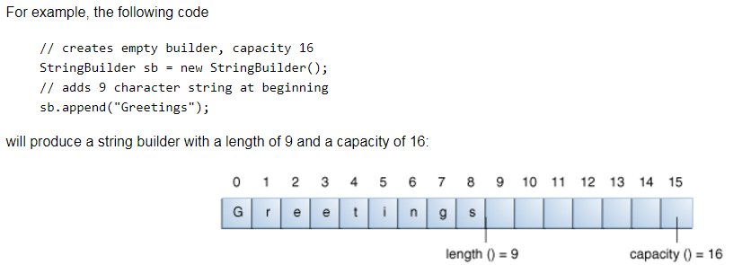
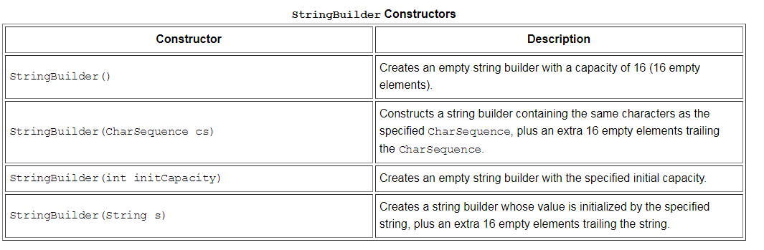

Slide 31
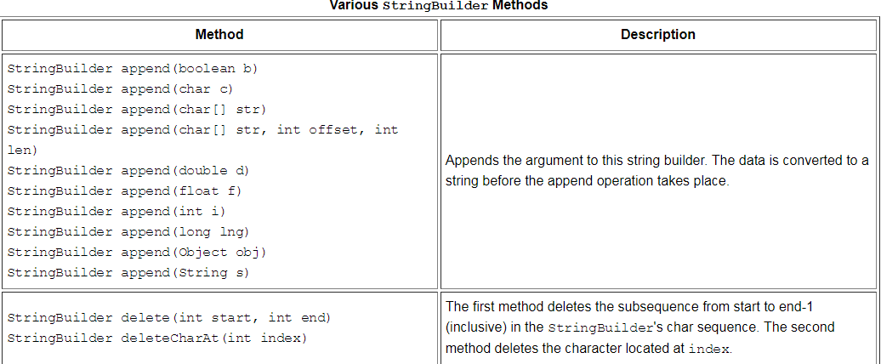

Slide 32
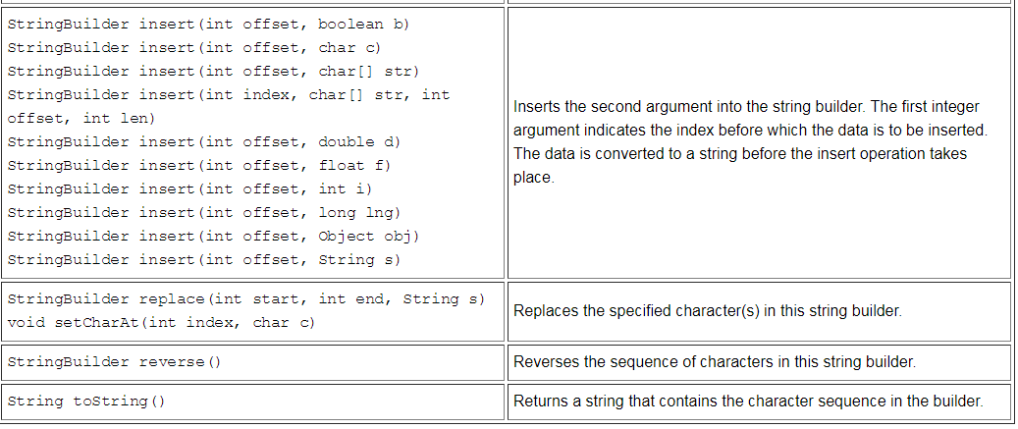
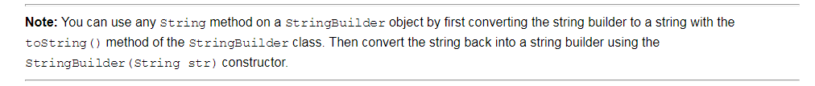

Slide 33
String Vs StringBuffer vs StringBuilder

Slide 34
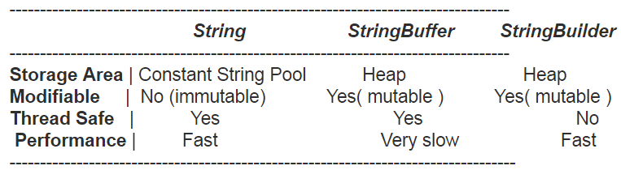
String
  immutable ( once created can not be changed )object ➔ thread safe.
  Value once assigned cannot be changed
  Example:
  String demo = " hello " ; // The object is stored in constant string pool and its value can not be modified.
  demo="Bye" ; //new "Bye" string is created in constant pool and referenced by the demo variable
  // "hello" string still exists in string constant pool and its value is not overrided but we lost reference to the "hello"string

Slide 35
StringBuffer
  means one can change the value of the object .
  The object created through StringBuffer is stored in the heap .
  StringBuffer has the same methods as the StringBuilder , but each method in StringBuffer is synchronized that is StringBuffer is thread safe .
  Due to this it does not allow two threads to simultaneously access the same method . Each method can be accessed by one thread at a time .
  But being thread safe has disadvantages too as the performance of the StringBuffer hits due to thread safe property . Thus StringBuilder is faster than the StringBuffer when calling the same methods of each class.
  String Buffer can be converted to the string by using toString() method.
Example
StringBuffer demo1 = new StringBuffer("Hello") ; // The object stored in heap and its value can be changed .
demo1=new StringBuffer("Bye"); // statement is right as it modifies the value which is allowed in the StringBuffer

Slide 36
StringBuilder
  main difference between the StringBuffer and StringBuilder is that StringBuilder is also not thread safe.
  StringBuilder is fast as it is not thread safe .
  Example:
  StringBuilder demo2= new StringBuilder("Hello");
  // The above object too is stored in the heap and its value can be modified
  demo2=new StringBuilder("Bye");
  // Above statement is right as it modifies the value which is allowed in the StringBuilder

Slide 37
Output:
Time taken by StringBuffer: 16ms
Time taken by StringBuilder: 0ms
public class ConcatTest{
public static void main(String[] args){
long startTime = System.currentTimeMillis();
StringBuffer sb = new StringBuffer("Java");
for (int i=0; i<10000; i++){
sb.append("Tpoint");
}
System.out.println("Time taken by StringBuffer: " + (System.currentTimeMillis() - startTime) + "ms");
startTime = System.currentTimeMillis();
StringBuilder sb2 = new StringBuilder("Java");
for (int i=0; i<10000; i++){
sb2.append("Tpoint");
}
System.out.println("Time taken by StringBuilder: " + (System.currentTimeMillis() - startTime) + "ms");
}
}

Slide 38
Output:
String: Geeks
StringBuilder: Geeksforgeeks
StringBuffer: Geeksforgeeks
// Java program to demonstrate difference between String,
// StringBuilder and StringBuffer
class Geeksforgeeks
{
// Concatenates to String
public static void concat1(String s1)
{
s1 = s1 + "forgeeks";
}
// Concatenates to StringBuilder
public static void concat2(StringBuilder s2)
{
s2.append("forgeeks");
}
// Concatenates to StringBuffer
public static void concat3(StringBuffer s3)
{
s3.append("forgeeks");
}
public static void main(String[] args)
{
String s1 = "Geeks";
concat1(s1); // s1 is not changed
System.out.println("String: " + s1);
StringBuilder s2 = new StringBuilder("Geeks");
concat2(s2); // s2 is changed
System.out.println("StringBuilder: " + s2);
StringBuffer s3 = new StringBuffer("Geeks");
concat3(s3); // s3 is changed
System.out.println("StringBuffer: " + s3);
}
}

Slide 39
Array methods
Part 3

Slide 40
Arrays
An array allows you to group data items together in a structure that is processed via an index.
They allow you to process like data items as a group.
Objects can also be stored in an array.
Form:
elementType[] arrayName = new elementType[size];
elementType[] arrayName = {list-of-values};
  arrayName represents a collection of array elements each element can store an item of type elementType
  The size maybe specified or calculated based on the number of values in the list-of-values.
  These items are stored sequentially.
  elementType can be primitive type or class

Slide 41
Array Assignment
When you declare an array
  int[] x = new int[5];
  int[] y = new int[5];
This allocates 5 storage locations x[0] through x[4];
Additionally java allocates an additional storage location x which contains the address of the start of the array.
Now,
y= x;
  Makes x and y occupy the same storage space!
  Very different than other assignment statements.
  They are now identical
  If you change elements of one it changes the other. (same storage space)----Reason in next slide

Slide 42
Array assignment
x
X[0]
X[1]
X[2]
X[3]
X[4]
0 | 0 | 0 | 0 | 0
y = x;
y
Old array y
0 | 0 | 0 | 0 | 0

Slide 43
java.util.Arrays static method -- equals
public static boolean equals(Object[] a, Object[] a2);
java.util.Arrays.equals(Object[] a, Object[] a2)method returns true if the two specified arrays of objects are equal to one another
The two arrays are considered equal if both arrays contain the same number of elements, and all corresponding pairs of elements in the two arrays are equal.
Two objects e1 and e2 are considered equal if (e1==null ? e2==null : e1.equals(e2)).
The two arrays are equal if they contain the same elements in the same order.
Two array references are considered equal if both are null.

Slide 44
import java.util.Arrays;
public class ArrayDemo {
  public static void main(String[] args) {
    // initiliazing three object arrays
    Object[] arr1 = new Object[] { 1, 123 };
    Object[] arr2 = new Object[] { 1, 123, 22, 4 };
    Object[] arr3 = new Object[] { 1, 123 };
    // comparing arr1 and arr2 boolean retval=Arrays.equals(arr1, arr2);
    System.out.println("arr1 and arr2 equal: " + retval);
    // comparing arr1 and arr3 boolean retval2=Arrays.equals(arr1, arr3);
    System.out.println("arr1 and arr3 equal: " + retval2);
  }
}
OUTPUT:
arr1 and arr2 equal: false arr1 and arr3 equal: true

Slide 45
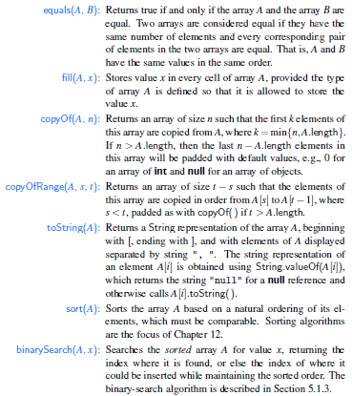
Methods in Java.util.Arrays

Slide 46
COLLECTION CLASSES- OVERVIEW
Part 4

Slide 47


Collections: Aren't they just arrays?
You might have noticed that we have not spent a lot of time discussing arrays in Java.
In procedural languages, arrays are often the only way to represent groups of data
  Array provides a mechanism for memory management
  Programmer must provide algorithms for managing the array
Arrays are, generally speaking, not Object Oriented
  They are not cohesive
  The array and the code to manage the array are not an single unit.

Slide 48
You'll never go back
In procedural languages, we are taught to separate the data from the management of data
  However, it is much easier to implement a data structure when the data is tightly coupled to the data structure.
The leads to reimplementation of many common structures
  Just ask a C programmer how many times he/she has implemented the linked list data structure.
  The algorithms are all the same, but because the implementation of the algorithm is tightly coupled to the data, the algorithms are not typically reusable.
Object oriented provides a much cleaner way of providing reusable data structures
  The data structure you want has probably already been implemented by someone else. Why re-invent the wheel?
  Once you've got the feel for collections, you'll never want to go back to arrays.

Slide 49
The Collection Interface
The Collection interface provides the basis for List-like collections in Java. The interface includes:
boolean add(Object)
boolean addAll(Collection)
void clear()
boolean contains(Object)
boolean containsAll(Collection)
boolean equals(Object)
boolean isEmpty()
Iterator iterator()
boolean remove(Object)
boolean removeAll(Collection)
boolean retainAll(Collection)
int size()
Object[] toArray()
Object[] toArray(Object[])

Slide 50
The Class Structure
The Collection interface is implemented by a class called AbstractCollection. Most collections inherit from this class.
Collection
List
Set
Maps
AbstractCollection
TreeMap
Hashtable
AbstractList
AbstractSet
HashMap
AbstractSequentialList
Vector
ArrayList
HashSet
TreeSet
LinkedList
LinkedHashMap

Slide 51
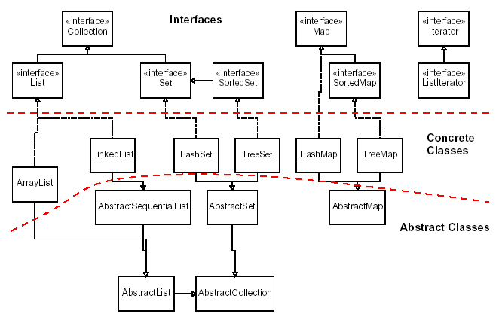
Java collections framework

Slide 52
List Interface
Lists allow duplicate entries within the collection
Lists are an ordered collection much like an array
  Lists grow automatically when needed
  The list interface provides accessor methods based on index
The List interface extends the Collections interface and add the following method definitions:
void add(int index, Object)
boolean addAll(int index, Collection)
Object get(int index)
int indexOf(Object)
int lastIndexOf(Object)
ListIterator listIterator()
ListIterator listIterator(int index)
Object remove(int index)
Object set(int index, Object)
List subList(int fromIndex, int toIndex)

Slide 53
Set Interface
The Set interface also extends the Collection interface but does not add any methods to it.
Collection classes which implement the Set interface have the add stipulation that Sets CANNOT contain duplicate elements
Elements are compared using the equals method
NOTE: exercise caution when placing mutable objects within a set. Objects are tested for equality upon addition to the set. If the object is changed after being added to the set, the rules of duplication may be violated.

Slide 54
Lists
Java provides 3 concrete classes which implement the list interface
  Vector
  ArrayList
  LinkedList
Vectors try to optimize storage requirements by growing and shrinking as required
  Methods are synchronized (used for Multi threading)
ArrayList is roughly equivalent to Vector except that its methods are not synchronized
LinkedList implements a doubly linked list of elements
  Methods are not synchronized

Slide 55
Sets
Java provides 2 concrete classes which implement the Set interface
  HashSet
  TreeSet
HashSet behaves like a HashMap except that the elements cannot be duplicated.
TreeSet behaves like TreeMap except that the elements cannot be duplicated.
Note: Sets are not as commonly used as Lists

Slide 56
The Map Interface
The Map interface provides the basis for dictionary or key-based collections in Java. The interface includes:
void clear()
boolean containsKey(Object)
boolean containsValue(Object)
Set entrySet()
boolean equals(Object)
Object get(Object)
boolean isEmpty()
Set keySet()
Object put(Object key, Object value)
void putAll(Map)
boolean remove(Object key)
int size()
Collection values()

Slide 57
Maps
Java provides 3 concrete classes which implement the list interface
  HashMap
  HashTable
  TreeMap
HashMap is the most commonly used Map.
  Provides access to elements through a key.
  The keys can be iterated if they are not known.
HashTable provides the same functionality as Map except that if the key object is no longer used, the key and it's value will be removed from the Map.
A Red-Black tree implementation of the Map interface

Slide 58
Most Commonly Use Methods
While it is a good idea to learn and understand all of the methods defined within this infrastructure, here are some of the most commonly used methods.
For Lists:
  add(Object), add(index, Object)
  get(index)
  set(index, Object)
  remove(Object)
For Maps:
  put(Object key, Object value)
  get(Object key)
  remove(Object key)
  keySet()

Slide 59
Which class should I use?
You'll notice that collection classes all provide the same or similar functionality. The difference between the different classes is how the structure is implemented.
  This generally has an impact on performance.
Use Vector
  Fast access to elements using index
  Optimized for storage space
  Not optimized for inserts and deletes
Use ArrayList
  Same as Vector except the methods are not synchronized. Better performance
Use linked list
  Fast inserts and deletes
  Stacks and Queues (accessing elements near the beginning or end)
  Not optimized for random access

Slide 60
Which class should I use?
Use Sets
  When you need a collection which does not allow duplicate entries
Use Maps
  Very Fast access to elements using keys
  Fast addition and removal of elements
  No duplicate keys allowed
When choosing a class, it is worthwhile to read the class's documentation in the Java API specification. There you will find notes about the implementation of the Collection class and within which contexts it is best to use.

Slide 61
COMPARABLE AND COMPARATOR
Part 5

Slide 62
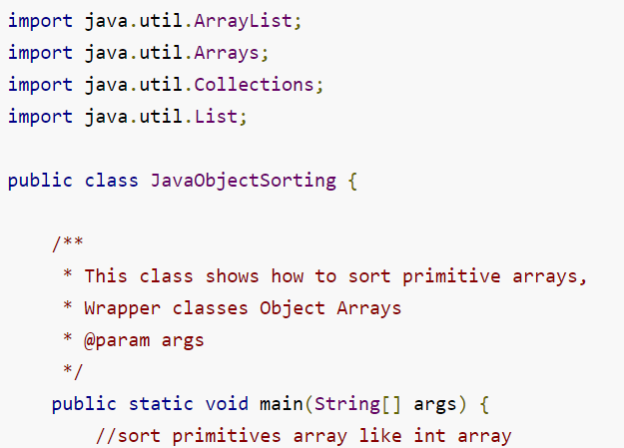
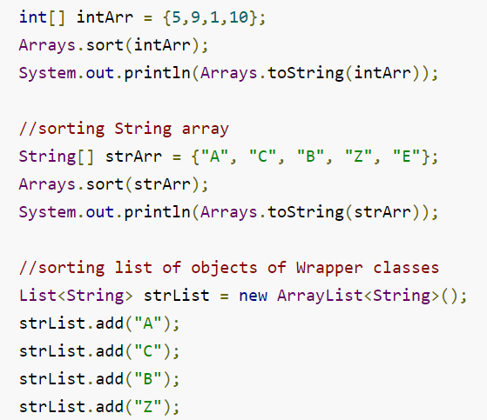
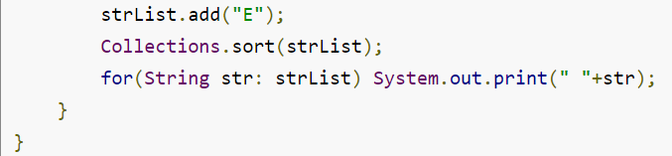
Sorting Arrays with primitive type
OUTPUT: [1, 5, 9, 10]
[A, B, C, E, Z]
A B C E Z

Slide 63
Let us consider sorting an class Employee
public class Employee
{
private int id;
private String name;
private int age;
private long salary;
public int getId() { return id; }
public String getName() { return name; }
public int getAge() { return age; }
public long getSalary() { return salary; }
public Employee(int id, String name, int age, int salary) { this.id = id; this.name = name; this.age = age; this.salary = salary; }
@Override
//this is overriden to print the user friendly information about the Employee
public String toString() {
return "[id=" + this.id + ", name=" + this.name + ", age=" + this.age + ", salary=" + this.salary + "]"; }
}

Slide 64
Let us consider sorting an class Employee
public class JavaObjectSorting {
  public static void main(String[] args) {
  //sorting object array
  Employee[] empArr = new Employee[4];
  empArr[0] = new Employee(10, "Mikey", 25, 10000);
  empArr[1] = new Employee(20, "Arun", 29, 20000);
  empArr[2] = new Employee(5, "Lisa", 35, 5000);
  empArr[3] = new Employee(1, "Pankaj", 32, 50000);
  //sorting employees array using Comparable interface implementation
  Arrays.sort(empArr);
  System.out.println("Default Sorting of Employees list:\n"+Arrays.toString(empArr));
}
}

Slide 65
Running the above gives the following runtime exception
Exception in thread "main" java.lang.ClassCastException:
com.journaldev.sort.Employee cannot be cast to java.lang.Comparable at
java.util.ComparableTimSort.countRunAndMakeAscending(ComparableTimSort.java:290) at
java.util.ComparableTimSort.sort(ComparableTimSort.java:157) at
java.util.ComparableTimSort.sort(ComparableTimSort.java:146) at java.util.Arrays.sort(Arrays.java:472) at
com.journaldev.sort.JavaSorting.main(JavaSorting.java:41)

Slide 66
How we overcome the above error???
Employee class has to implement Comparable interface if we want to use Arrays or Collections sorting methods.
That override and define the compareTo() method which is the only method in Comparable interface.
Modified Employee class in next slide

Slide 67
import java.util.Comparator;
public class Employee implements Comparable<Employee>
{
private int id; private String name; private int age; private long salary;
public Employee(int id, String name, int age, int salary)
{ this.id = id; this.name = name; this.age = age; this.salary = salary; }
//add get methods appropriately
@Override
public int compareTo(Employee emp) {
/*let's sort the employee based on id in ascending order returns a negative integer, zero, or a positive integer as this employee id is less than, equal to, or greater than the specified object. */
return (this.id - emp.id);
}
@Override
public String toString()
{ return "[id=" + this.id + ", name=" + this.name + ", age=" + this.age + ", salary=" + this.salary + "]";
}
}

Slide 68
Now Let us consider sorting an class Employee
public class JavaObjectSorting {
public static void main(String[] args) {
//sorting object array
  Employee[] empArr = new Employee[4];
  empArr[0] = new Employee(10, "Mikey", 25, 10000);
  empArr[1] = new Employee(20, "Arun", 29, 20000);
  empArr[2] = new Employee(5, "Lisa", 35, 5000);
  empArr[3] = new Employee(1, "Pankaj", 32, 50000);
  //sorting employees array using Comparable interface implementation
  Arrays.sort(empArr);
  System.out.println("Default Sorting of Employees list:\n"+Arrays.toString(empArr));
  }
}

Slide 69
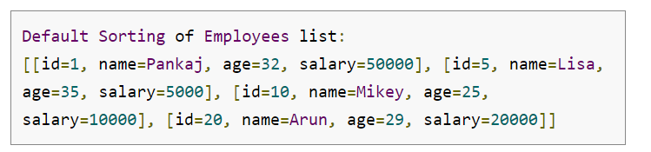
OUTPUT:

Slide 70
Comparable and Comparators
You will have noted that some classes provide the ability to sort elements.
  How is this possible when the collection is supposed to be de-coupled from the data?
Java defines two ways of comparing objects:
  The objects implement the Comparable interface
  A Comparator object is used to compare the two objects
If the objects in question are Comparable, they are said to be sorted by their "natural" order.
Comparable object can only offer one form of sorting. To provide multiple forms of sorting, Comparators must be used.

Slide 71
The Comparable Interface
You may recall a method from the String class:
  int compareTo(Object)
  This method returns:
    0 if the Strings are equal
    <0 if this object is less than the specified object
    >0 if this object is greater than the specified object.
The Comparable interface contains the compareTo method.
  If you wish to provide a natural ordering for your objects, you must implement the Comparable Interface
  Any object which is "Comparable" can be compared to another object of the same type.
There is only one method defined within this interface. Therefore, there is only one natural ordering of objects of a given type/class.

Slide 72
The Comparator Interface
The Comparator interface defines two methods:
  int compare(Object, Object)
  0 if the Objects are equal
  <0 if the first object is less than the second object
  >0 if the first object is greater than the second object.
  boolean equals(Object)
  returns true if the specified object is equal to this comparator. ie. the specified object provides the same type of comparison that this object does.

Slide 73
Using Comparators
Comparators are useful when objects must be sorted in different ways.
  For example
    Employees need to be sorted by first name, last name, start date, termination date and salary.
      A Comparator could be provided for each case
      The comparator interrogates the objects for the required values and returns the appropriate integer based on those values.
    The appropriate Comparator is provided a parameter to the sorting algorithm.

Slide 74
Comparator Example on Employee Class
import java.util.Comparator;
public class Employee implements Comparable<Employee>
{
// include the code from previous example as it is
/** * Comparator to sort employees list or array in order of Salary */
public static Comparator<Employee> SalaryComparator = new Comparator<Employee>() { //anonymous class
@Override
public int compare(Employee e1, Employee e2)
{ return (int) (e1.getSalary() - e2.getSalary()); }
};
/** * Comparator to sort employees list or array in order of Age */ 4
public static Comparator<Employee> AgeComparator = new Comparator<Employee>() { //anonymous class
@Override
public int compare(Employee e1, Employee e2)
{ return e1.getAge() - e2.getAge(); }
};

Slide 75
Comparator Example on Employee Class
/** * Comparator to sort employees list or array in order of Name */
public static Comparator<Employee> NameComparator = new Comparator<Employee>() { //anonymous class
@Override
public int compare(Employee e1, Employee e2)
{ return e1.getName().compareTo(e2.getName()); }
};
}

Slide 76
Running the following code
public class JavaObjectSorting {
public static void main(String[] args) {
    Employee[] empArr = new Employee[4];
    empArr[0] = new Employee(10, "Mikey", 25, 10000);
    empArr[1] = new Employee(20, "Arun", 29, 20000);
    empArr[2] = new Employee(5, "Lisa", 35, 5000);
    empArr[3] = new Employee(1, "Pankaj", 32, 50000);
  / /sort employees array using Comparator by Salary
  Arrays.sort(empArr, Employee.SalaryComparator);
  System.out.println("Employees list sorted by Salary:\n"+Arrays.toString(empArr));
  //sort employees array using Comparator by Age
  Arrays.sort(empArr, Employee.AgeComparator);
  System.out.println("Employees list sorted by Age:\n"+Arrays.toString(empArr));
  //sort employees array using Comparator by Name Arrays.sort(empArr, Employee.NameComparator); System.out.println("Employees list sorted by Name:\n"+Arrays.toString(empArr));
  }
}

Slide 77
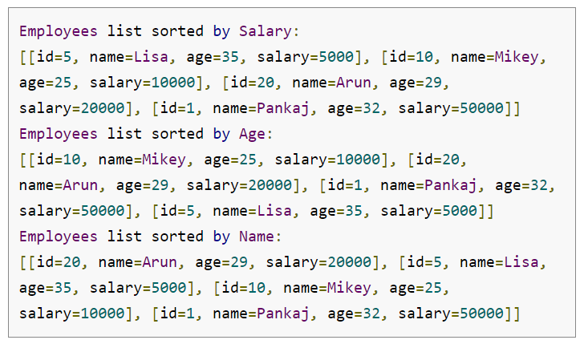
Gives the following output

Slide 78
Here is the separate class implementation of Comparator interface that will compare two Employees object first on their id and if they are same then on name.
import java.util.Comparator;
public class EmployeeComparatorByIdAndName implements Comparator<Employee>
{
@Override
public int compare(Employee o1, Employee o2)
{
int flag = o1.getId() - o2.getId();
if(flag==0)
flag = o1.getName().compareTo(o2.getName());
return flag;
}
}

Slide 79
Run the following code
public class JavaObjectSorting {
public static void main(String[] args) {
    Employee[] empArr = new Employee[4];
    empArr[0] = new Employee(10, "Mikey", 25, 10000);
    empArr[1] = new Employee(20, "Arun", 29, 20000);
    empArr[2] = new Employee(5, "Lisa", 35, 5000);
    empArr[3] = new Employee(1, "Pankaj", 32, 50000);
    //Employees list sorted by ID and then name using Comparator class
    empArr[0] = new Employee(1, "Mikey", 25, 10000);
    Arrays.sort(empArr, new EmployeeComparatorByIdAndName());
    System.out.println("Employees list sorted by ID and Name:\n"+Arrays.toString(empArr));
  }
}

Slide 80
We get the output
Employees list sorted by ID and Name:
[[id=1, name=Mikey, age=25, salary=10000], [id=1, name=Pankaj, age=32, salary=50000], [id=5, name=Lisa, age=35, salary=5000], [id=10, name=Mikey, age=25, salary=10000]]

Slide 81
Comparable vs Comparator
Comparable interface can be used to provide single way of sorting whereas Comparator interface is used to provide different ways of sorting.
For using Comparable, Class needs to implement it whereas for using Comparator we don’t need to make any change in the class.
Comparable interface is in java.lang package whereas Comparator interface is present in java.util package.
We don’t need to make any code changes at client side for using Comparable, Arrays.sort() or Collection.sort() methods automatically uses the compareTo() method of the class. For Comparator, client needs to provide the Comparator class to use in compare() method.

Slide 82
Collection Algorithms
Java provides a series of pre-written algorithms based on the Collection interface
These algorithms are accessible through the Collections class.
  They are made available as static methods
  Some methods are overloaded to provide natural ordering or ordering using a Comparator
For Example:
  The method max has two implementations
    Object max(Collection)
      returns the maximum object based on the natural ordering of the objects (Comparable)
    Object max(Collection, Comparator)
      returns the maximum object based on the order induced by the comparator

Slide 83
Vectors AND Arraylist
Part 6

Slide 84
A Weakness of Arrays
Suppose we declare an array of “Student” objects:
Student[] students = new Student[10];
What if a new student joins the class?
The size of an array cannot be increased after it is instantiated

Slide 85
class Vector
The class Vector can be used to implement a list, replacing a simple array
The size of a Vector object can grow/shrink during program execution
The Vector will automatically grow to accommodate the number of elements you put in it

Slide 86
class Vector (continued)
The class Vector is contained in the package java.util
Programs must include either:
  import java.util.*;
  import java.util.Vector;

Slide 87
Vector Declaration
Declare/initialize
Vector<Student> students = new Vector<Student>();
The syntax <…> is used to declare the type of object that will be stored in the Vector
If you add a different type of object, an exception is thrown
Not strictly necessary, but highly recommended (compiler warning)

Slide 88
Vector Size/Capacity
The size of a vector is the number of elements
The capacity of a vector is the maximum number of elements before more memory is needed
If size exceeds capacity when adding an element, the capacity is automatically increased
  Declares a larger storage array
  Copies existing elements, if necessary
  Growing the capacity is expensive!
By default, the capacity doubles each time

Slide 89
Setting Initial Capacity
If you know you will need a large vector, it may be faster to set the initial capacity to something large
Vector<Student> students = new Vector<Student>(1000);

Slide 90
Size and capacity
Get the current size and capacity:
Vector<Student> students = new Vector<Student>(1000);
students.size(); // returns 0
students.capacity(); // returns 1000
Setting size and capacity:
// adds null elements or deletes elements if necessary
students.setSize(10);
// increases capacity if necessary
students.ensureCapacity(10000);

Slide 91
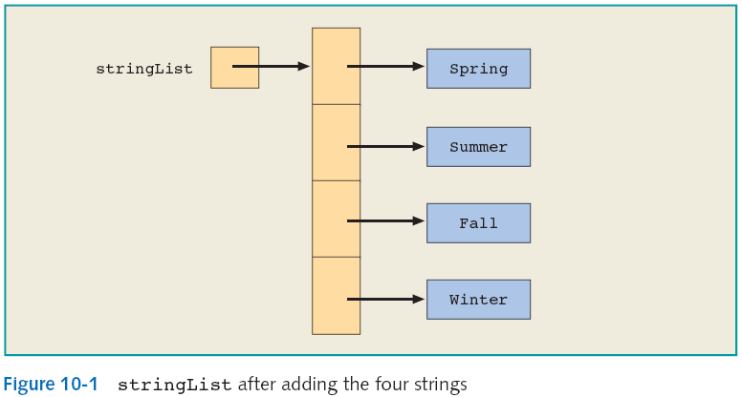
Adding Elements
Vector<String> stringList = new Vector<String>();
stringList.add("Spring");
stringList.add("Summer");
stringList.addElement("Fall");
stringList.addElement("Winter");
add and addElement
have identical functionality

Slide 92
Accessing Elements
stringList.get(0); // “Spring”
stringList.get(3); // “Winter”
stringList.get(4); // ArrayIndexOutOfBounds Exception

Slide 93
Primitive Data Types and the class Vector
Every component of a Vector object is a reference
  Primitive data types are not objects
Corresponding to each primitive data type, Java provides a wrapper class
JDK 5.0 provides autoboxing and auto-unboxing of primitive data types

Slide 94
Primitive Data Types and the class Vector (continued)
Creating a Vector of Integer objects
  Vector<Integer> list = new Vector<Integer>();
  list.add(13); // with autoboxing
  list.add(new Integer(25)); // without autoboxing
  int tmp = list.get(0); // with autounboxing
  int tmp2 = list.get(0).intValue() //without

Slide 95
Vector and the foreach loop
Each Vector object is a collection of elements
  You can use a foreach loop to process its elements
  Exactly like using a foreach loop with an array
Syntax:
  for (type identifier : vectorObject)
  statements

Slide 96
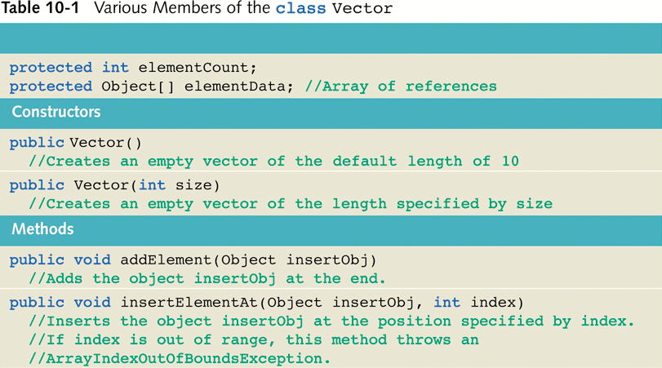
Members of the class Vector

Slide 97
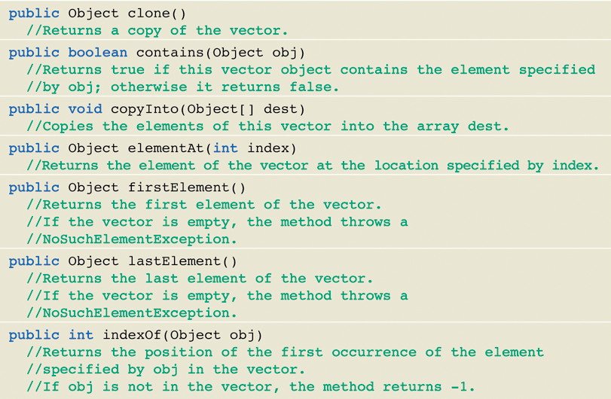
Members of the class Vector (continued)

Slide 98
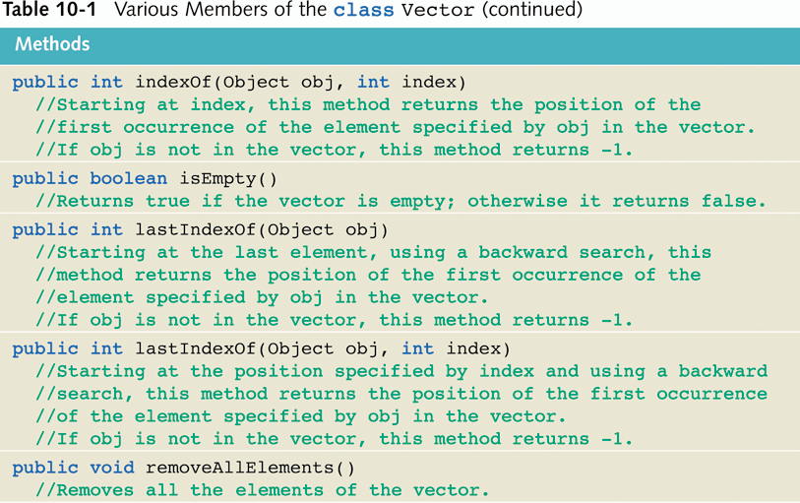
Members of the class Vector (continued)

Slide 99
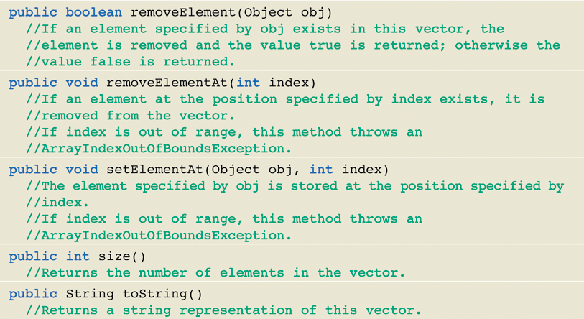
Members of the class Vector (continued)

Slide 100
What’s an Array List
ArrayList is
  a class in the standard Java libraries that can hold any type of object
  an object that can grow and shrink while your program is running (unlike arrays, which have a fixed length once they have been created)
In general, an ArrayList serves the same purpose as an array, except that an ArrayList can change length while the program is running
Aug 9, 2007

Slide 101
The ArrayList Class
The class ArrayList is implemented using an array as a private instance variable
  When this hidden array is full, a new larger hidden array is created and the data is transferred to this new array
Aug 9, 2007
Copyright © 2008 Pearson Addison-Wesley.
All rights reserved

Slide 102
Using the ArrayList Class
In order to make use of the ArrayList class, it must first be imported
import java.util.ArrayList;
An ArrayList is created and named in the same way as object of any class, except that you specify the base type as follows:
  ArrayList<BaseType> aList =
  new ArrayList<BaseType>();
Aug 9, 2007
Copyright © 2008 Pearson Addison-Wesley.
All rights reserved

Slide 103
Creating an ArrayList
An initial capacity can be specified when creating an ArrayList as well
  The following code creates an ArrayList that stores objects of the base type String with an initial capacity of 20 items
ArrayList<String> list = new ArrayList<String>(20);
  Specifying an initial capacity does not limit the size to which an ArrayList can eventually grow
Note that the base type of an ArrayList is specified as a type parameter
Aug 9, 2007
Copyright © 2008 Pearson Addison-Wesley.
All rights reserved

Slide 104
Adding elements to an ArrayList
The add method is used to add an element at the “end” of an ArrayList
    list.add("something");
  The method name add is overloaded
  There is also a two argument version that allows an item to be added at any currently used index position or at the first unused position
Aug 9, 2007
Copyright © 2008 Pearson Addison-Wesley.
All rights reserved

Slide 105
How many elements?
The size method is used to find out how many indices already have elements in the ArrayList
    int howMany = list.size();
The set method is used to replace any existing element, and the get method is used to access the value of any existing element
    list.set(index, "something else");
    String thing = list.get(index);
size is NOT capacity
  size is the number of elements currently stored in the ArrayList
  Capacity is the maximum number of elements which can be stored. Capacity will automatically increase as needed
Aug 9, 2007
Copyright © 2008 Pearson Addison-Wesley.
All rights reserved

Slide 106
ArrayList code Example
// Note the use of Integer, rather than int
public static void main( String[ ] args)
{
ArrayList<Integer> myInts = new ArrayList<Integer>(25);
System.out.println( “Size of myInts = “ + myInts.size());
for (int k = 0; k < 10; k++)
myInts.add( 3 * k );
myInts.set( 6, 44 );
System.out.println( “Size of myInts = “ + myInts.size());
for (int k = 0; k < myInts.size(); k++)
System.out.print( myInts.get( k ) + “, “ );
}
// output
Size of myInts = 0
Size of myInts = 10
0, 3, 6, 9, 12, 15, 44, 21, 24, 27
Aug 9, 2007

Slide 107
ArrayList methods (1)
add(value) | appends value at end of list
add(index, value) | inserts given value just before the given index, shifting subsequent values to the right
clear() | removes all elements of the list
indexOf(value) | returns first index where given value is found in list (-1 if not found)
get(index) | returns the value at given index
remove(index) | removes/returns value at given index, shifting subsequent values to the left
set(index, value) | replaces value at given index with given value
size() | returns the number of elements in list
toString() | returns a string representation of the list such as "[3, 42, -7, 15]"

Slide 108
ArrayList methods (2)
addAll(list) addAll(index, list) | adds all elements from the given list to this list (at the end of the list, or inserts them at the given index)
contains(value) | returns true if given value is found somewhere in this list
containsAll(list) | returns true if this list contains every element from given list
equals(list) | returns true if given other list contains the same elements
iterator() listIterator() | returns an object used to examine the contents of the list (seen later)
lastIndexOf(value) | returns last index value is found in list (-1 if not found)
remove(value) | finds and removes the given value from this list
removeAll(list) | removes any elements found in the given list from this list
retainAll(list) | removes any elements not found in given list from this list
subList(from, to) | returns the sub-portion of the list between indexes from (inclusive) and to (exclusive)
toArray() | returns the elements in this list as an array

Slide 109
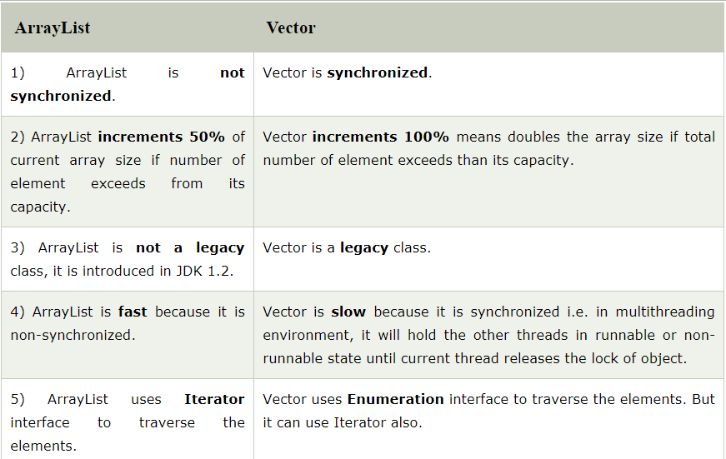

Slide 110
Iterator AND Iterable
Part 7

Slide 111
The Collection Interface Hierarchy
<<interface>>
Iterable
<<interface>>
Collection
<<interface>>
List
<<interface>>
Set
<<interface>>
SortedSet
<<interface>>
Queue

Slide 112
Iterating over a Collection
Many times, we need to write code that retrieves all the elements of a collection one at a time in order to process them.
We call this iterating over the collection.
Java library has a way to conveniently accomplish the process of accessing (visiting or retrieving) each element of a collection once.
The core of this approach is based on two interfaces:
  Iterable<T>
  Iterator<T>

Slide 113
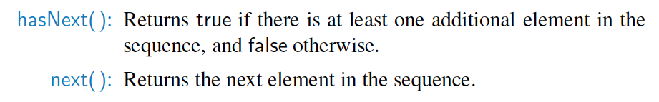
Iterators
An iterator is a software design pattern that abstracts the process of scanning through a sequence of elements, one element at a time.
© 2014 Goodrich, Tamassia, Goldwasser
Lists and Iterators

Slide 114
The Iterable Interface
Java defines a parameterized interface, named Iterable, that includes the following single method:
  iterator( ): Returns an iterator of the elements in the collection.
An instance of a typical collection class in Java, such as an ArrayList, is iterable (but not itself an iterator); it produces an iterator for its collection as the return value of the iterator( ) method.
Each call to iterator( ) returns a new iterator instance, thereby allowing multiple (even simultaneous) traversals of a collection.
© 2014 Goodrich, Tamassia, Goldwasser
Lists and Iterators

Slide 115
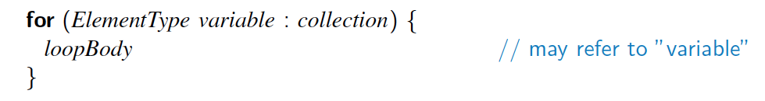
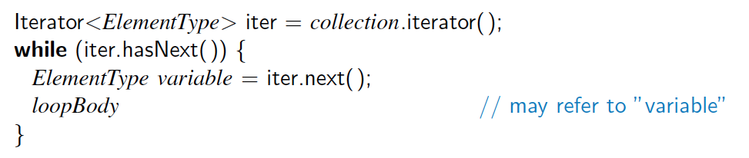
The for-each Loop
Java’s Iterable class also plays a fundamental role in support of the “for-each” loop syntax:
  is equivalent to:
© 2014 Goodrich, Tamassia, Goldwasser
Lists and Iterators

Slide 116
Summary: How to use iterator
Obtain an iterator
  by calling the collection's iterator( ) method
Have the loop iterate as long as hasNext( ) returns true.
Within the loop, obtain each element by calling next( ).
  Note: For the data structures that we will be implementing this semester, you need to implement the iterator() for them.

Slide 117
Iterator example – while loop
import java.util.*;
public final class LoopStyles {
public static void main( String... aArguments ) {
List<String> flavours = new ArrayList<String>();
flavours.add("chocolate");
flavours.add("strawberry");
flavours.add("vanilla");
useWhileLoop( flavours );
useForLoop( flavours );
}
private static void useWhileLoop( Collection<String> aFlavours ) {
Iterator<String> flavoursIter = aFlavours.iterator();
while ( flavoursIter.hasNext() ){
System.out.println( flavoursIter.next() );
}
}

Slide 118
Iterator example – for loop
// Use for - each loop. More easy to make iteration over arrays or other collections
private static void useForLoop( Collection<String> aFlavours ) {
for ( String flavour : aFlavours ) {
System.out.println( flavour );
}
}
}

Slide 119
Iterable implementation - Example
import java.util.ArrayList;
import java.util.Iterator;
public class Animal implements Iterable<String>
{
private ArrayList<String> animal = new ArrayList<String>();
public Animal(ArrayList animal) { this.animal = animal; }
public ArrayList getAnimal() { return animal; }
@Override
public Iterator<String> iterator()
{
return new AnimalIterator(this);
}
}

Slide 120
public class AnimalIterator<String> implements Iterator<Object> {
private ArrayList<?> animal;
private int position;
public AnimalIterator(Animal animalBase) {
this.animal = animalBase.getAnimal(); }
@Override
public boolean hasNext() {
if (position < animal.size()) return true; else return false;
}
@Override
public Object next() {
Object aniObj = animal.get(position);
position++; return aniObj; }
@Override public void remove() { animal.remove(position); }
}

Slide 121
Testing previous slide
import java.util.ArrayList;
public class TestIterator
{
public static void main(String args[])
{
ArrayList<String> animalList = new ArrayList();
animalList.add("Horse");
animalList.add("Lion");
animalList.add("Tiger");
Animal animal = new Animal(animalList);
for (String animalObj : animal)
{
System.out.println(animalObj);
}
}
}

Slide 122
PSEUDORANDOM NUMBERS
Part 8

Slide 123
Random number generation in Java
Java has a built-in class, java.util.Random, whose instances are pseudorandom number generators, that is, objects that compute a sequence of numbers that are statistically random.
These sequences are not actually random, however, in that it is possible to predict the next number in the sequence given the past list of numbers.
Indeed, a popular pseudorandom number generator is to generate the next number, next, from the current number, cur, according to the formula (in Java syntax):
next = (a * cur + b) % n;
where a, b, and n are appropriately chosen integers, and % is the modulus operator.
Something along these lines is, in fact, the method used by java.util.Random objects, with n = 2⁴⁸.
Since the next number in a pseudorandom generator is determined by the previous number(s), such a generator always needs a place to start, which is called its seed. The sequence of numbers generated for a given seed will always be the same.
  The seed for an instance of the java.util.Random class can be set in its constructor or with its setSeed( ) method.

Slide 124
Methods of the java.util.Random
Methods of the java.util.Random class include the following:
  nextBoolean( ): Returns the next pseudorandom boolean value.
  nextDouble( ): Returns the next pseudorandom double value, between 0.0 and 1.0.
  nextInt( ): Returns the next pseudorandom int value.
  nextInt(n): Returns the next pseudorandom int value in the range from 0 up to but not including n.
  setSeed(s): Sets the seed of this pseudorandom number generator to the long s.

Slide 125
import java.util.Arrays;
import java.util.Random;
/** Program showing some array uses. */
public class ArrayTest {
public static void main(String[ ] args) {
int data[ ] = new int[10];
Random rand = new Random( ); // a pseudo-random number generator
rand.setSeed(System.currentTimeMillis( )); // use current time as a seed
// fill the data array with pseudo-random numbers from 0 to 99, inclusive
for (int i = 0; i < data.length; i++)
data[i] = rand.nextInt(100); // the next pseudo-random number
int[ ] orig = Arrays.copyOf(data, data.length); // make a copy of the data array
System.out.println("arrays equal before sort: "+Arrays.equals(data, orig));
Arrays.sort(data); // sorting the data array (orig is unchanged)
System.out.println("arrays equal after sort: " + Arrays.equals(data, orig));
System.out.println("orig = " + Arrays.toString(orig));
System.out.println("data = " + Arrays.toString(data));
}
}

Slide 126
Output
We show a sample output of this program below:
      arrays equal before sort: true
      arrays equal after sort: false
      orig = [41, 38, 48, 12, 28, 46, 33, 19, 10, 58]
      data = [10, 12, 19, 28, 33, 38, 41, 46, 48, 58]
In another run, we got the following output:
      arrays equal before sort: true
      arrays equal after sort: false
      orig = [87, 49, 70, 2, 59, 37, 63, 37, 95, 1]
      data = [1, 2, 37, 37, 49, 59, 63, 70, 87, 95]

Slide 127
OBJECT CLONING
Part 9

Slide 128
Object cloning in Java
The object cloning is a way to create exact copy of an object.
For this purpose, clone() method of Object class is used to clone an object.
The java.lang.Cloneable interface must be implemented by the class whose object clone we want to create.
If we don't implement Cloneable interface, clone() method generates CloneNotSupportedException.
The clone() method is defined in the Object class. Syntax of the clone() method is as follows:
protected Object clone() throws CloneNotSupportedException

Slide 129
Inside cloning
1) If the class has only primitive data type members then a completely new copy of the object will be created and the reference to the new object copy will be returned.
2) If the class contains members of any class type then only the object references to those members are copied and hence the member references in both the original object as well as the cloned object refer to the same object.

Slide 130
Example
public class BathTub {
private String tubName;
public BathTub(String tubName){ this.tubName = tubName; }
//Any Getters-Setters goes here
}
class BathRoom implements Cloneable{
  private int legth;
  private int width;
  private int height;
  private BathTub bathTub;
  public BathRoom(int legth, int width, int height, BathTub bathTub){
  this.legth = legth;
  this.width = width;
  this.height = height;
  this.bathTub = bathTub;
  }

Slide 131
  public Object clone()throws CloneNotSupportedException{
  return super.clone();
  }
  public static void main(String args[])
  {
    try{
      BathTub bathTub = new BathTub("BreezeTub");
      BathRoom bathRoom_1 = new BathRoom(10,10,12, bathTub);
      BathRoom bathRoom_2 = (BathRoom)bathRoom_1.clone();
      System.out.println(bathRoom_1.length+" "+bathRoom_1.width+” ”+ bathRoom_1.height+ “ “+bathRoom_1.bathTub.tubName);
      System.out.println(bathRoom_2.length+" "+bathRoom_2.width+” ”+ bathRoom_2.height+ “ “+bathRoom_2.bathTub.tubName);
    }
    catch(CloneNotSupportedException c){ }
  }
}
Output:
10 10 12 BreezeTub
10 10 12 BreezeTub

Slide 132
What happens in the above example?
Here super.clone() is getting called inside clone().
As we know, clone() is declared in Object, so it is inherited by every Java object.
Calling super.clone() copies our superclass' fields and makes bitwise copies of the fields. This known as shallow copy, which means when you copy BathRoom using clone(), the field's length, width, and height are getting copied with their respective values, but bathTub is copied by reference — bit by bit, the memory address is getting copied.

Slide 133
Why use clone() and not new??
As you can see in the above example, both reference variables have the same value. Thus, the clone() copies the values of an object to another. So we don't need to write explicit code to copy the value of an object to another.
If we create another object by new keyword and assign the values of another object to this one, it will require a lot of processing on this object. So to save the extra processing task we use clone() method.

Slide 134
To avoid shallow copy:
Any changes you make to bathTub of the original object will be reflected in the cloned object and vice versa. To solve this, we need deep copy.
Now, we need to change the BathTub class as well implement the "Cloneable" interface and clone() method, then call the clone() method of the BathTub object inside the clone() method of the BathRoom object.

Slide 135
Example
public class BathTub {
private String tubName;
public BathTub(String tubName){ this.tubName = tubName; }
//Any Getters-Setters goes here
  public Object clone() {
  try {
  return (BathTub)super.clone();
  }
  catch (CloneNotSupportedException e) {
  System.out.println("CloneNotSupportedException comes out : "+e.getMessage());
  }
}
class BathRoom implements Cloneable{
  private int length;
  private int width;
  private int height;
  private BathTub bathTub;

Slide 136
  public BathRoom(int legth, int width, int height, BathTub bathTub){
  this.legth = legth;
  this.width = width;
  this.height = height;
  this.bathTub = bathTub;
  }
  public Object clone()throws CloneNotSupportedException{
  BathRoom bathRoom = null;
  try {
  bathRoom = (BathRoom)super.clone();
  }
  catch (CloneNotSupportedException e) {
    System.out.println("CloneNotSupportedException comes out : "+e.getMessage());
  }
  bathRoom.bathTub = (BathTub) bathTub.clone();
  return bathRoom;
  }

Slide 137
  public static void main(String args[])
  {
    try{
      BathTub bathTub = new BathTub("BreezeTub");
      BathRoom bathRoom_1 = new BathRoom(10,10,12, bathTub);
      BathRoom bathRoom_2 = (BathRoom)bathRoom_1.clone();
      System.out.println(bathRoom_1.length+" "+bathRoom_1.width+” ”+ bathRoom_1.height+ “ “+bathRoom_1.bathTub.tubName);
      System.out.println(bathRoom_2.length+" "+bathRoom_2.width+” ”+ bathRoom_2.height+ “ “+bathRoom_2.bathTub.tubName);
    }
    catch(CloneNotSupportedException c){ }
  }
}
Output:
10 10 12 BreezeTub
10 10 12 BreezeTub

Slide 138
FILE OPERATION
Part 10

Slide 139
Why Files?
In all the programs we have written so far, any data we need has been either
  hard coded into the program
  String name = "Cathy";
  – or read in from the keyboard using a Scanner object
  Scanner kybd = new Scanner(System.in);
  System.out.println("What is your name?");
  name = kybd.next();
• It is tedious to type in all the data to be processed each time the program is run
• It is not very useful if the data and results cannot be saved
– imagine a payroll program where all information about the employees has to be entered each time the program is run

Slide 140
Need for File Access
Files saved for word processors, spreadsheet programs, etc.
Saved on secondary memory
  hard disks, floppy disks, CD-ROMs, etc.
Requirements information stored in secondary memory
  can be retrieved in the future
  kept separate from other documents, programs, etc.

Slide 141
Operations in files
Create
Read
Update
Delete

Slide 142
Reading Files
The same applies for both console input and file input
We can use a different version of a Scanner that takes a File instead of System.in
Everything works the same!

Slide 143
Reading Files
To read from a disk file, construct a FileReader
Then, use the FileReader to construct a Scanner object
FileReader rdr = newFileReader("input.txt");
Scanner fin = new Scanner(rdr);

Slide 144
Reading Files
You can use File instead of FileReader
  Has an exists() method we can call to avoid FileNotFoundException
File file = new File ("input.txt");
Scanner fin;
if(file.exists()){
fin = new Scanner(file);
} else {
//ask for another file
}

Slide 145
Reading Files
Once we have a Scanner, we can use methods we already know:
  next, nextLine, nextInt, etc.
Reads the information from the file instead of console

Slide 146
Writing to a File
We will use a PrintWriter object to write to a file
  What if file already exists? → Empty file
  Doesn’t exist? → Create empty file with that name
How do we use a PrintWriter object?
  Have we already seen one?

Slide 147
Writing to a File
The out field of the System class is a PrintWriter object associated with the console
  We will associate our PrintWriter with a file now
PrintWriter fout = new PrintWriter("output.txt");
fout.println(29.95);
fout.println(new Rectangle(5, 10, 15, 25));
fout.println("Hello, World!");
This will print the exact same information as with System.out (except to a file “output.txt”)!

Slide 148
Closing a File
Only main difference is that we have to close the file stream when we are done writing
If we do not, not all output will written
At the end of output, call close()
fout.close();

Slide 149
Closing a File
Why?
  When you call print() and/or println(), the output is actually written to a buffer. When you close or flush the output, the buffer is written to the file
  The slowest part of the computer is hard drive operations – much more efficient to write once instead of writing repeated times

Slide 150
File Locations
When determining a file name, the default is to place in the same directory as your .class files
If we want to define other place, use an absolute path (e.g. c:\My Documents)
in = new FileReader(“c:\\homework\\input.dat”);
Why \\ ?

Slide 151
import java.io.FileReader;
import java.io.IOException;
import java.io.PrintWriter;
import java.util.Scanner;
public class LineNumberer{
public static void main(String[] args){
Scanner console = new Scanner(System.in);
System.out.print("Input file: ");
String inFile = console.next();
System.out.print("Output file: ");
String outFile = console.next();
try{
FileReader reader = new FileReader(inFile);
Scanner in = new Scanner(reader);

Slide 152
      PrintWriter out = new PrintWriter(outputFileName);
      int lineNumber = 1;
      while (in.hasNextLine()){
      String line = in.nextLine();
      out.println("/* " + lineNumber + " */ " + line);
      lineNumber++;
      }
      out.close();
    } catch (IOException exception){
    System.out.println("Error processing file: " + exception);
    }
  }
}

Slide 153
Self study Portion
Serialization
StringTokenizer in Java

